Slide 1
Genotype x Environment Interaction

Slide 2
Defining the Environment
Predictable environmental variables
  Soil type, planting date, planting rate
Unpredictable environmental variables
  Rainfall, temperature, biotic stresses

Slide 3
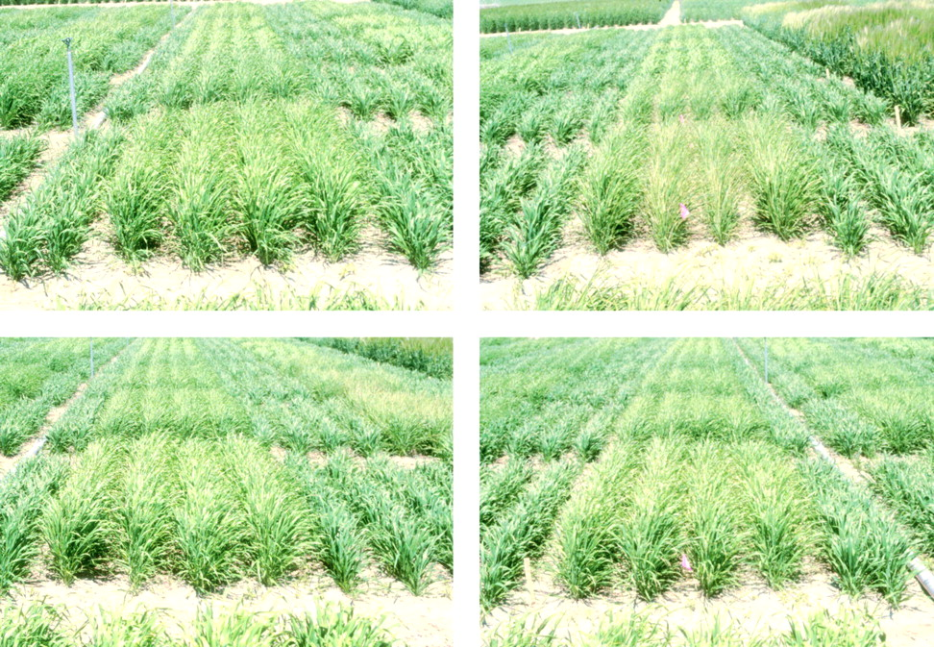
G x E Interaction Impedes Selection Progress
If selection gains in one environment are not expressed in the other target environment(s) this is problematic

Slide 4
The Breeder’s Goal
Develop varieties with best adaptation to the target environment
G x E interaction influences selection locations and strategies

Slide 5
What are the Causes of G x E Interaction?
Genotype rank changes
Differences in scale

Slide 6
G x E Interaction: Heterogeneous

Slide 7
G x E Interaction: Crossover

Slide 8
G x E Interaction: Combined

Slide 9
Types of GxE Interaction
NO INTERACTION | ENV. 1 | ENV. 2 | DIFFERENCE
Genotype A | 10 | 14 | +4
Genotype B | 16 | 20 | +4
Difference | +6 | +6
NON CROSSOVER INTERACTION | ENV. 1 | ENV. 2 | DIFFERENCE
Genotype A | 10 | 14 | +4
Genotype B | 16 | 24 | +8
Difference | +6 | +10
CROSSOVER INTERACTION | ENV. 1 | ENV. 2 | DIFFERENCE
Genotype A | 16 | 14 | -2
Genotype B | 10 | 20 | +10
Difference | -6 | +6
Note: that if F = M2/M1 is significant, this means that
σ²_{GxE} is significantly different from zero.

Slide 10
Scale Differences
If the magnitude of genetic variance is much greater in environment 1 than in environment 2, this will be manifest as G x E variance
Drought environment: Genetic variance very low
Versus
Irrigated environment : Genetic variance very high
This difference will show up as G x E interaction variance

Slide 11
How do we detect G x E?
Breeders establish a network of testing locations that sample the target environment
Tests are carried out for multiple years
Experimental breeding lines are compared with standard check cultivars
From an ANOVA of these experiments we can estimate genetic, environmental and G x E interaction variance

Slide 12
Consider the Linear Model

Slide 13
What Constitutes an Environment?
Each location-year combination may be considered a unique environment
For example: 25 soybean lines are tested for 3 years in Lexington and 2 years in Princeton for a total of 5 environments

Slide 14
Combined ANOVA over Years and Locations
Source | df | MS | E(MS)
Years (Y) | Y-1
Locations (L) | L-1
Replications (R) | LY(R-1)
Y x L | (Y-1)(L-1)
Genotypes (G) | G-1 | M5
G x Y | (G-1)(Y-1) | M4
G x L | (G-1)(L-1) | M3
G x Y x L | (G-1)(Y-1)(L-1) | M2
Error | LY(G-1)(R-1) | M1
Note: that if F = M2/M1 is significant, this means that
σ²_{GxYXL} is significantly different from zero.

Slide 15
The ANOVA Can Tells Us About the Nature of the Variation
Variance components can be estimated from the EMS
The relative size of these variance components can inform the breeder about the importance of the various kinds of G x E interaction

Slide 16
Combined ANOVA over Years and Locations (3 reps, 3 locs, 3 yr)
Source | df | MS | E(MS)
Years (Y) | Y-1
Locations (L) | L-1
Replications (R) | LY(R-1)
Y x L | (Y-1)(L-1)
Genotypes (G) | G-1 | 6070
G x Y | (G-1)(Y-1) | 490
G x L | (G-1)(L-1) | 220
G x Y x L | (G-1)(Y-1)(L-1) | 40
Error | LY(G-1)(R-1) | 10

Slide 17
Variance Component Example
Variance Component | Value
σ²_{G} | 200
σ²_{GL} | 20
σ²_{GY} | 50
σ²_{GLY} | 10
In this case, genetic variance is MUCH greater than
any of the G x E interaction variances.
This is good news for the breeder.

Slide 18
We Can Use Variance Component Estimates to Allocate Resources
The variance of a genotype mean can be expressed as:

Slide 19
In our example, this would be:

Slide 20
Assessing G x E Interaction
The location means used in the 232 Line example are referred to as the environmental index in the statistical approach known as Stability Analysis
Covered in Murphy and Fehr
Widely used but equally widely criticized

Slide 21
Yield of Line 232 Plotted against Location Mean Yields

Slide 22
Stability Analysis: Genotype 2 More Responsive to Environment; Genotype 1 Better Suited to Low Yield Env.

Slide 23
Issues with Stability Analysis
Env. Index not independent of genotypic effects
2 environments may have the same mean yield for completely different reasons; can affect deviations from regression line
Differences in regression lines may account for low percentage of GxE

Slide 24
Non Parametric Analysis
Mean CV
1
2
Mean Yield
3
4
Group 1: High Yield, Low CV; Group 2: High Yield, High CV
Group 3: Low Yield, Low CV; Group 4: Low Yield, High CV
CV=Coefficient of Variation = (STD DEV)/Mean

Slide 25
Multivariate Analysis
The objective is to remove noise from the data, reveal any underlying patterns to the data, and give the data a structure
The procedure is to create variable that are linear functions of the existing data
The new linear functions hopefully explain most of the variation in the data set and reveal relationships between entries or between testing locations

Slide 26
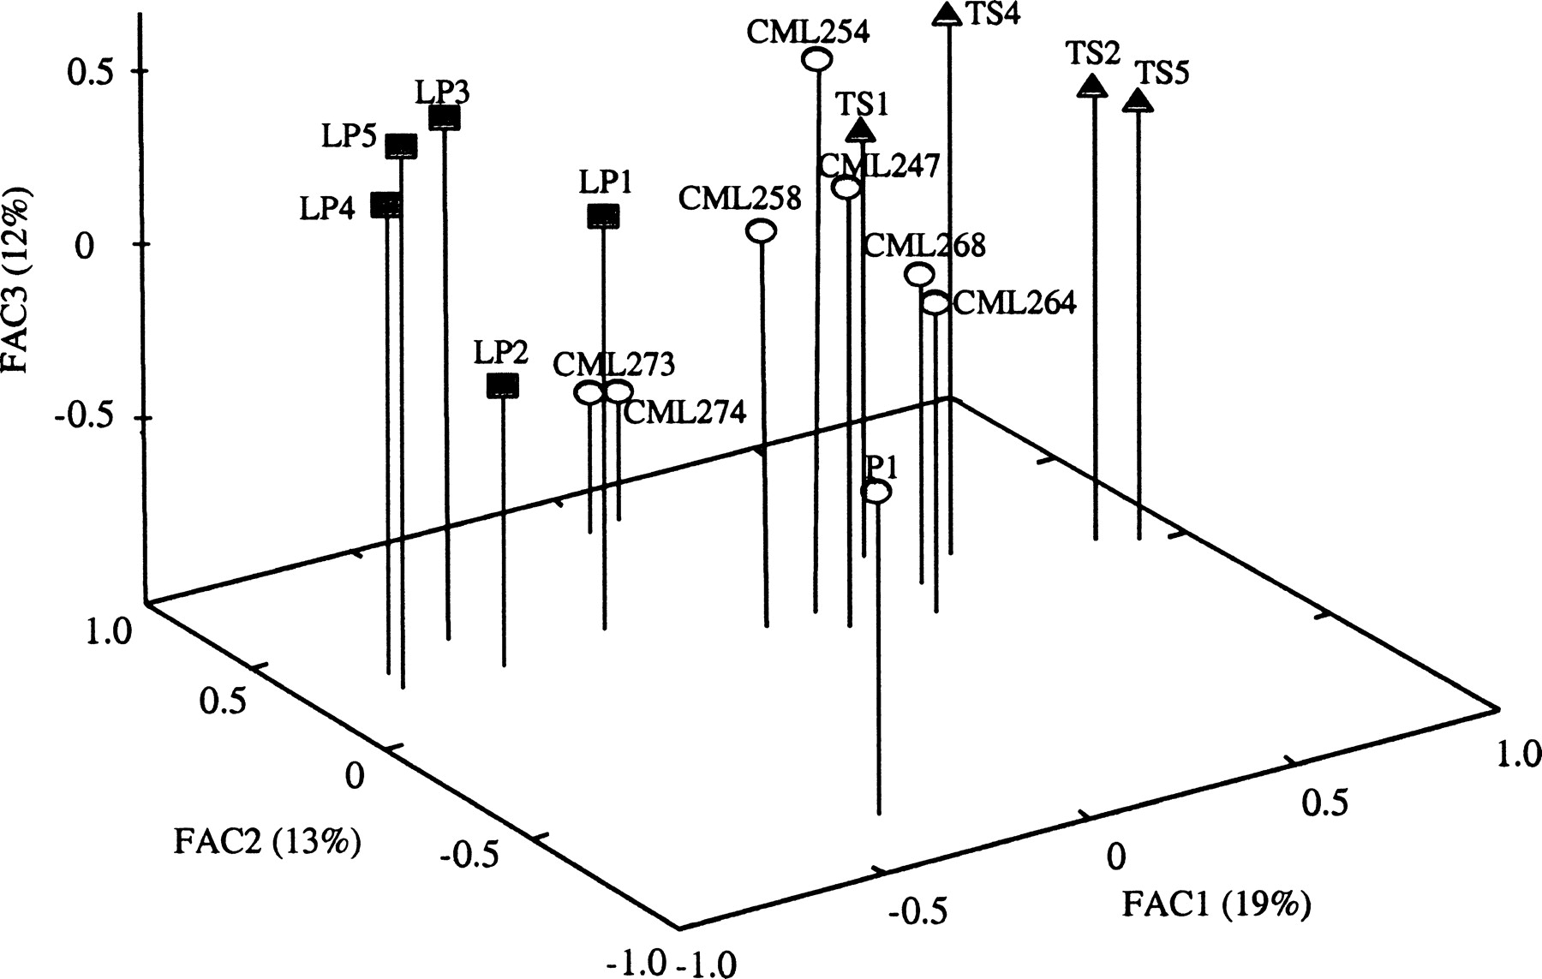
Multivariate Analysis
If we can show a high correlation between two of our testing locations, for example, we may be able to eliminate one of them.

Slide 27
GGE Biplot
A type of multivariate analysis
Developed by Weikai Yan, who gave it the GGE designation because:
“it is impossible to separate the G from the GE”

Slide 28
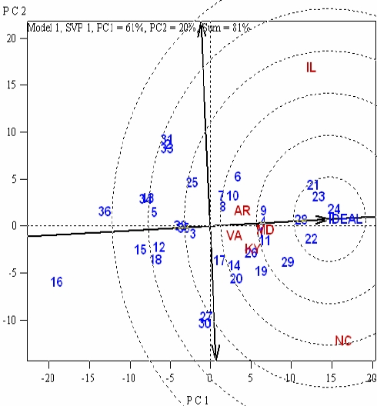
The doubled-arrow line approximated the Genotype x Environment (GE) interaction associated with each entry. The greater the projection onto the line, the greater the instability. For example entry 30 was less stable than entry 3. Entries 24, 23, 22, 21 and 28 were ranked closest to 'Ideal' in terms of low and stable DON scores.

Slide 29
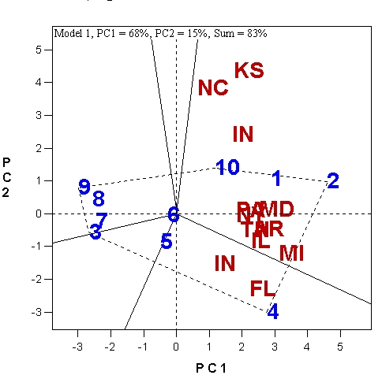
There are Two Mega
Environments: IN and FL are in one, where entry 4 is the top entry; KS, NC, MD, IL, MI etc are in the other where entry 2 is the top entry.

Slide 30
Genotype x Environment Interaction
This topic has been studied to death!
Yet it still ranks as one of the major concerns of the plant breeder
Part of this stems from the G x Y interaction – there is NO substitute for years in testing
Some have proposed a “parsimonious” design that creates all of the stresses at once

